Slide 1
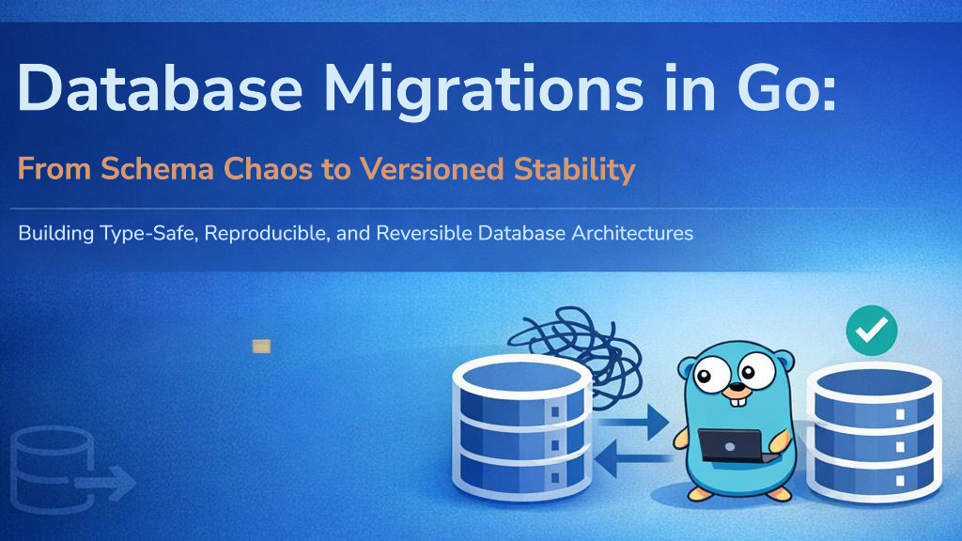

Slide 2


WHAT MIGRATIONS ARE AND WHY THEY MATTER
WHAT ARE THEY?
WHY MIGRATIONS?
Database migrations are:
Version-controlled database changes
Structured updates to database schemas
A way to keep databases consistent across environments
For Creating tables, Adding columns, Updating indexes and Removing obsolete fields
“Migrations are like Git for your database”
Ensures every developer and environment (Dev, Staging, Prod) has the exact same database structure at any given commit
Version control
Team collaboration
Reliable deployments
Easy rollback support
Better CI/CD workflows.

Slide 3
THE TOOL ECOSYSTEM
TOOL | STYLE | PRIMARY BENEFIT
golang-migrate | Pure SQL | Industry standard; massive database support
goose | SQL + Go | Allows complex data transformations in pure Go code.
ent | Schema-driven | ORM that automatically generates migrations from structs.
sql-migrate | SQL | Focuses on simplicity and Gorp-based compatibility

Slide 4

GOLANG-MIGRATE AND HOW IT WORKS
golang-migrate
How it works
A migration tool designed for Go applications
Each migration contains:
Up Migration which applies changes
Down Migration which reverts changes
Follows a naming convention:
Sequential numbering/TimeStamps
Descriptive names
Separate up/down files
000001_create_users_table.up.sql
000001_create_users_table.down.sql
Features:
Database schema versioning
Up & down migrations
CLI and Go package support
Multiple database support: PostgreSQL, MySQL, SQLite
Official Repo:
https://github.com/golang-migrate/migrate

Slide 5






THE ENTITY WORKFLOW
1. Define Struct
2. Create Migration
3. Execute
Create your Go model representing the database entity.
Or if using sqlc, you would just relax so it creates your Go model structs for you
Generate Up/Down SQL files with schema changes.
Run m.Up() programmatically at app startup.
Or use the CLI

Slide 6
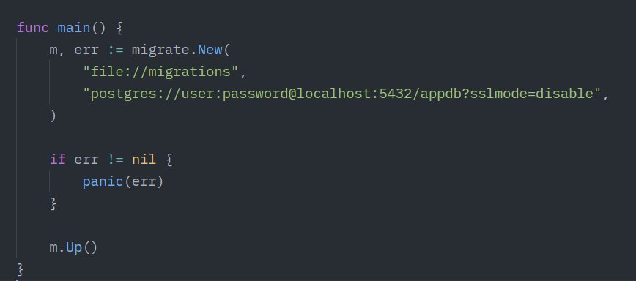
CREATING MIGRATIONS
Example integration in Go Code, programmatically

Slide 7
COMMON PROBLEMS & BEST PRACTICES
You might run into a dirty database state if a migration fails halfway. This could be due to:
Database server restarting before a migration could complete
Typo in a SQL statement or trying to create a table which already exists
Race conditions or locking issues when multiple instances of a Go app start simultaneously, etc.
The migrate force version is your fix
This forces the migration to the last successful version
Use your very first file for DB extensions and basic setup
Always be explicit in your queries. Especially when using sqlc or sqlx
Keep migrations small
Use descriptive names
Always create rollback scripts
Never modify old production migrations
Test migrations before deployment
Backup production databases

Slide 8
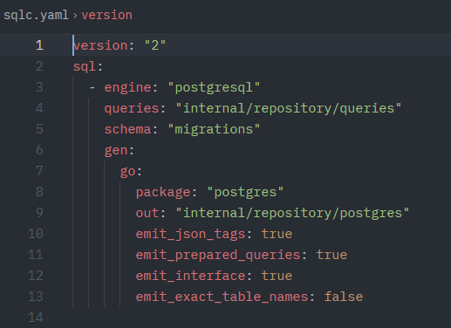
THE GOLDEN TRIANGLE
Migrations + sqlc = Safety
1. Migrations: Define the schema (Source of Truth).
2. sqlc: Reads migrations and generates type-safe code.
3. App Code: Consumes code. If schema changes, compilation fails.
Eliminate runtime "column not found" errors forever.

Slide 9


Reliable Systems
Database migrations are not just a tool, but a discipline. By mastering them in Go, you ensure your data architecture evolves with the same rigor as your code.

Slide 10
Questions?
Thank you for joining the session on Go Migrations.

